Slide 1



Project 1 Real-Time Data Analytics Capacity
Business Requirement – Workshop (Marketing)
March 2018

Slide 2
Agenda
1
Project Introduction (5 minutes)
2
Timeline and Milestones (5 minutes)
3
Objective of Workshop (10 minutes)
4
Current Status Understanding (5 minutes)
5
Requirement Clarification and Prioritisation (2 hours)
6
Wrap-up (5 minutes)

Slide 3




Vision: Integrating corporate-wide data to unlock business value through real time analytics and visualization
Project Introduction
Data sources
Sales
Marketing
E-Commerce
Social media
Supply chain
Corporate functions
External data
Business Driver
DATA STORE WITH SINGLE SOURCE OF TRUTH
Real-time analytics engine
Reports catalogue
Scenario analysis
Predictive analytics
Reporting & visualisation
Analysis
Consumer analytics
Dynamic pricing
Reporting
Demand forecast
Decision support
Data governance
Organisation & Capability
Process & Technology
Policy & Standard
Service Management

Slide 4
Process: Collect your business requirement to define dashboard content to enable your analytical capability
Project Introduction
Project objectives for Phase 2B and Wave 1 deliverables
Select suitable vendors for solution deployment
Build user-friendly dashboard for Sales & Marketing
Enhance people capability on data analytics
Project scope for Phase 2B deliverables
A
B
C
D
E
Reporting & visualisation
IT vendor contracting
Define technical scope, launch final evaluation and contracting activities with vendor
Implementation Planning
Define detailed execution plan including activities, timeline and R&R
Business requirements for S&M
Analyse existing report and data sets, conduct interview with users and define BRD
Data collection mechanism
Review and refine existing data collection approach and solution architecture
SAP report transition plan
Support to develop transition plan of existing reports to new platform

Slide 5
Agenda
1
Project Introduction (5 minutes)
2
Timeline and Milestones (5 minutes)
3
Objective of Workshop (10 minutes)
4
Current Status Understanding (5 minutes)
5
Requirement Clarification and Prioritisation (2 hours)
6
Wrap-up (5 minutes)

Slide 6
Expect: Continual and stepwise roll-out of dashboard between Q2 and Q3 FY18/19
Timeline and milestones
FY18/19
Wave 1 activities for Digital Project 1
Q1
Q2
Q3
Q4
Build data analytics capability (IT, KPMG)
Continue to hire new data analytics professionals (as necessary)
Up-skill IT team to support data related activities
Build pilot data analytics platform for prioritised sales
and marketing requirement (IT, business, KPMG, vendor)
Review and prioritise user requirement
Complete data model, ETL mechanism and reporting designs
Build reporting functionality and conduct SIT by sprints
Execute UAT and training by sprints
Reporting capability cut-over and go-live by sprints
Continue transition of existing reports
Start nursing period after go-live
Key milestone
Key deliverable
Iterative activity
Notes: Defined activities of 3 waves will start in China first. For Hong Kong, areas of focus will be identified and assessed in the course of Wave 1.

Slide 7
Now: Document your requirement now, share it with vendor to construct dashboard in Q1 and Q2 FY18/19
Timeline and milestones
We are here
FY 17/18
2018
FY 18/19
Phase 2B activities for Digital Project 1
Jan
Feb
Mar
Apr
21.
28.
04.
11.
18.
25.
04.
11.
18.
25.
01.
08.
15.
22.
IT Vendor contracting
Define detailed technical scope for vendors on Wave 1
Wave 1 technical scope
Prepare and issue RFP to shortlisted vendors
Conduct POC with shortlisted implementation partners
Vendor contract completes
Wait for response from vendors and launch final presentation
Select final vendors and conduct contracting activities accordingly
Wave 1 Implementation planning
Define detailed execution plan including activities, timeline and R&R
Wave 1 Execution plan
Execute communication activities for Project 1 implementation
Business requirement assessment for Sales and Marketing
Collect, review and analyse data sets and calculation logic of existing reports
Business requirement document
Conduct analytics requirement gathering workshop(s) with key users
Assess data quality and availability to prioritise KPIs for implementation
Document and refine business requirements for visualization of in-scope KPIs
Data collection approach and mechanism (including ETL approach)
Understand existing data collection approach during requirement workshop
Data collection mechanism
Assess existing data collection mechanism
Define target data collection mechanism and communicate with users
Refine solution architecture based on selected vendor and target collection mechanism
Transition plan of existing reports to new platform
Identify existing SAP data-based report for migration
Develop transition plan of existing SAP data-based reports to new platform
Key deliverable

Slide 8
Agenda
1
Project Introduction (5 minutes)
2
Timeline and Milestones (5 minutes)
3
Objective of Workshop (10 minutes)
4
Current Status Understanding (5 minutes)
5
Requirement Clarification and Prioritization (2 hours)
6
Wrap-up (5 minutes)

Slide 9
Task: Prioritize KPI, identify who and how often we need it – and assess its general data quality
A
B
C
Importance Prioritisation
How important or influential does this KPI matter for you to make a decision?
How does this KPI relate to your goal – in both short (e.g. 3 to 6 months) and long term (e.g. 3 to 5 years)?
How can this KPI help solve your business problem?
Accessing Characteristics
Who will require the KPI for their actions or benefit?
What will the access level for each KPI – e.g. who will simply receive and view the dashboard vs. who may create or change it?
How often will you access or view the KPI?
Data Collection & Quality
What is the data source of the KPI? How the data was collected – e.g. system auto-generated vs. manual input?
What do you think about its data quality?
Do you have to spend a lot of time on dealing with it?
What kind of format of the data you have?

Slide 10
Agenda
1
Project Introduction (5 minutes)
2
Timeline and Milestones (5 minutes)
3
Objective of Workshop (10 minutes)
4
Current Status Understanding (5 minutes)
5
Requirement Clarification and Prioritisation (2 hours)
6
Wrap-up (5 minutes)

Slide 11
Recap: Previous business requirements from Alexandra in October 2017
Current Status Understanding
Overview of business requirements for KPIs – Data Analytics
KPI | Interpretation | Automated capability¹ | Priority² | Existing/ Future KPI | Current data source | Future solution³
Marketing
Brand value % share | Market share of brand based on category and region | Y | High | Existing | SAP External report | Management dashboard with visualization tool and data warehouse solution New social media analytics tools
SPPD by region and brand | Amount of sales per point of distribution by region and brand | Y | High | Existing and Future | SAP External report
Awareness | Brand awareness based on GRP | Y | High | Existing | External report
Usage | Measure of customer behaviour such as purchase habit | Y | High | Existing and Future | External report
BUMO | Brand used most often by customers | Y | High | Existing and Future | External report
ND | Number of outlets carrying the product | Y | High | Existing and Future | SAP External report
GRP | Percentage of audience reached by advertisement | Y | Medium | Existing and Future | External report
Notes:
1) Feasibility of automation depends on the data availability of new applications to be implemented in other digitisation projects.
2) KPIs with high priority will be first automated in Wave 1, while the implementation of medium priority KPIs will follow at later stage of Wave 1 and onwards
3) New solution indicated in the future solution will be assessed and evaluated in the following phases.

Slide 12
Recap: Previous business requirements from Alexandra in October 2017
Current Status Understanding
Overview of business requirements for KPIs – Data Analytics
KPI | Interpretation | Automated capability¹ | Priority² | Existing/ Future KPI | Current data source | Future solution³
Marketing
SOV | Share of conversation with target consumers the brand owns vs competitors | Y | Medium | Existing and Future | External report | Management dashboard with visualisation tool and data warehouse solution New social media analytics tools
A&P spend by brand advertising | Advertising and promotion spend by brand, campaign and type of advertising mean | Y | Medium | Existing | SAP
Mobile engagement | Number of accessing marketing content via handheld | Y | Medium | Existing and Future | Mobile app
Mobile sharing | Number of sharing contents with other users | Y | Medium | Existing and Future | Mobile app
Social buzz topic reach | Number of Vitasoy Weibo topic being mentioned/ commented/ discussed | Y | Medium | Existing and Future | Web platform
No. of bus displaying body advertising | Number of bus in China displaying ads on the bus body by variant and region | Y | Medium | Existing and Future | External report
Search index | Amount of appearance in search results of 3rd party search platforms | Y | Medium | Existing and Future | External report
Notes:
1) Feasibility of automation depends on the data availability of new applications to be implemented in other digitisation projects.
2) KPIs with high priority will be first automated in Wave 1, while the implementation of medium priority KPIs will follow at later stage of Wave 1 and onwards
3) New solution indicated in the future solution will be assessed and evaluated in the following phases

Slide 13
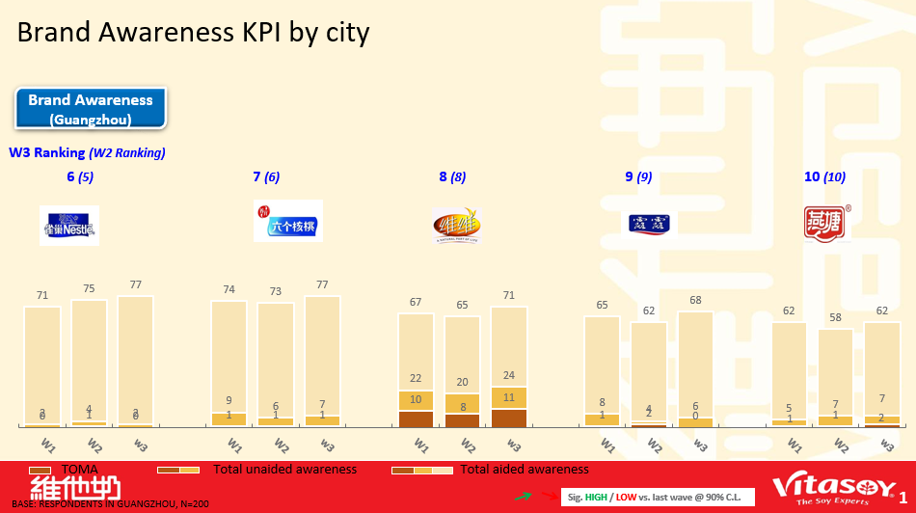
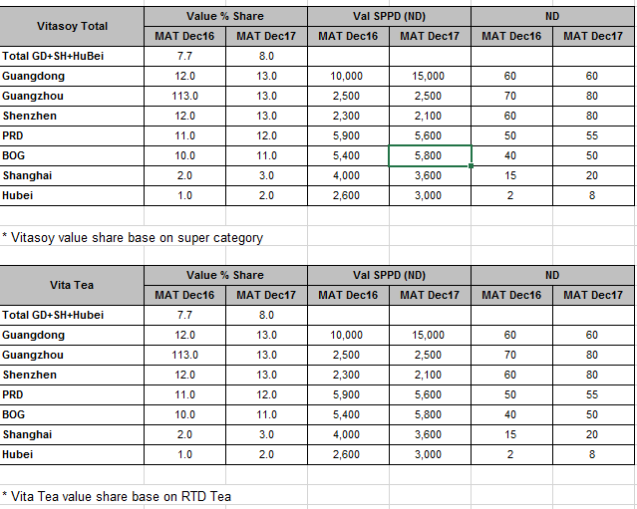
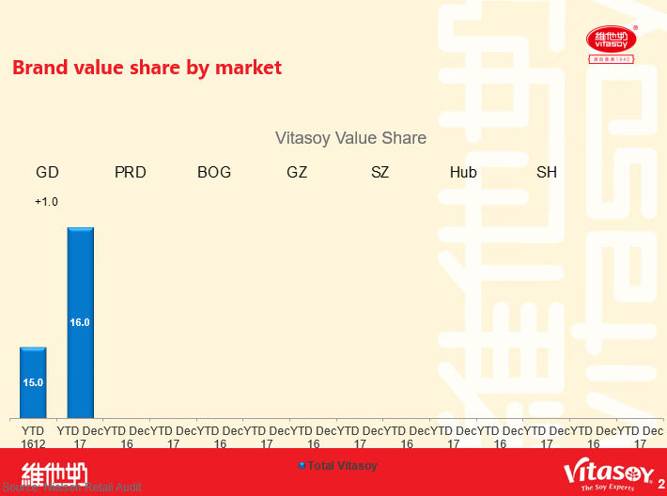
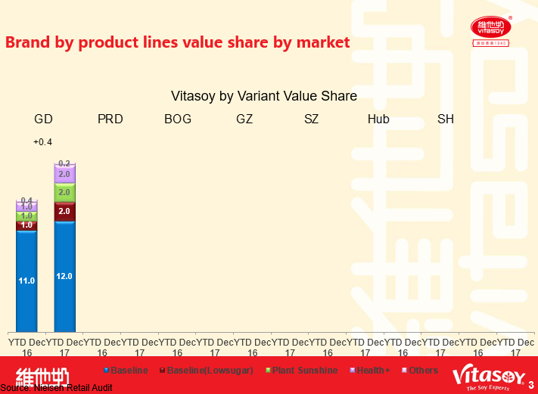
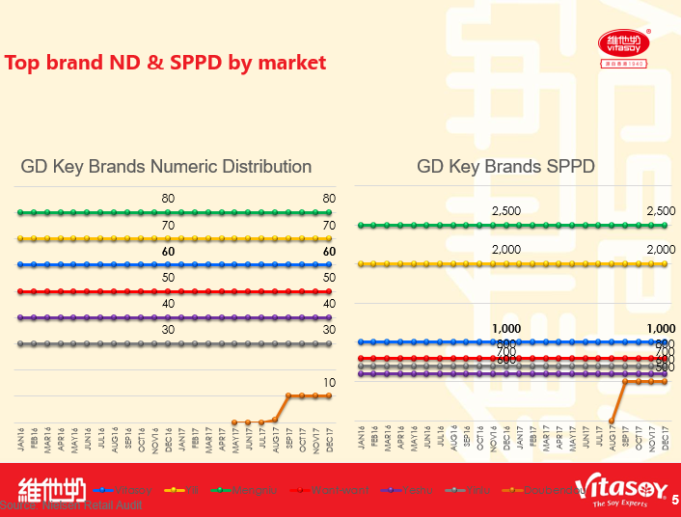
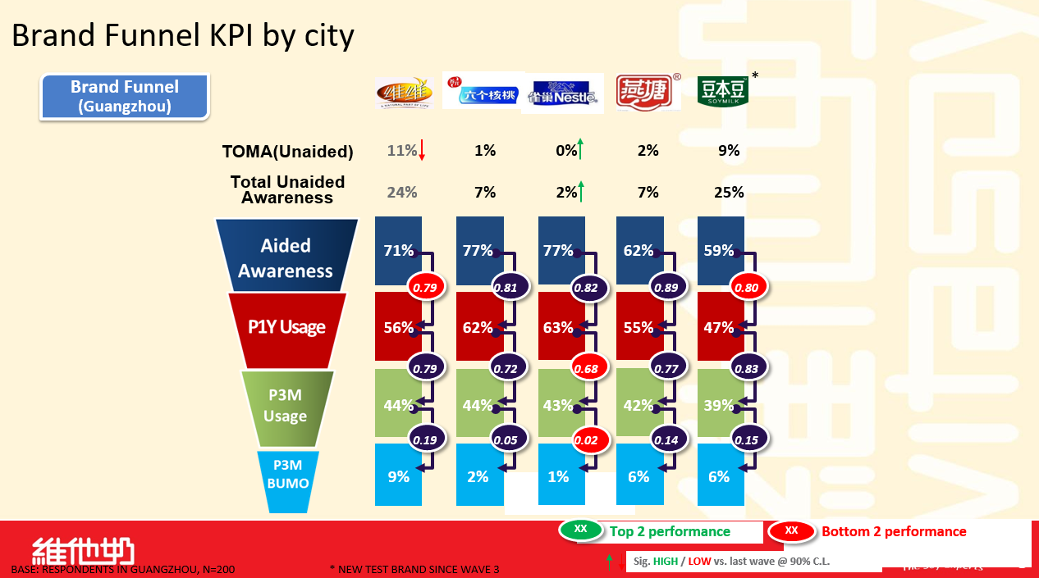
Recap: Existing reports from Yoyo
Current Status Understanding
1
2
3
Brand Health Study Report
Awareness (Aided, Unaided and Top-of mind)
Usage (Past 1 Year and Past 3 Months)
Brand Used Most Often (BUMO)
Flash Report Demo
Brand value % share
SPPD (Amount of sales per point of distribution)
ND (Number of outlets carrying products)
Offtake Monthly Report
Brand Value Share
Super Category Sales Value
SPPD (Amount of sales per point of distribution)
ND (Number of outlets carrying products)

Slide 14
Agenda
1
Project Introduction (5 minutes)
2
Timeline and Milestones (5 minutes)
3
Objective of Workshop (10 minutes)
4
Current Status Understanding (5 minutes)
5
Requirement Clarification and Prioritisation (2 hours)
6
Wrap-up (5 minutes)

Slide 15
Now: We have 20 KPI stated by Alexandra and appeared in existing report shared by Yoyo

Slide 16
1. Brand Awareness
What we know so far
What we have to decide
Importance by Alexandra - High
Item | Top of Mind Awareness Unaided Awareness Aided Awareness
Importance Prioritisation | KPI (High / Medium / Low)
 | Dimension for deep-dive
Accessing Characteristics | Data Source (SAP, OA, 100 Sales, VWin, External Report)
 | Data Format (MS Excel, MS PowerPoint, Database)
 | Data Quality (High / Medium / Low)
Data Collection & Quality | How often? (Daily / Weekly / Monthly / Quarterly / Half-yearly / Yearly)
 | Who? (CEO, CFO, Brand Manager, Media Manager, Marketing Manager, etc)
Item
Top of Mind Awareness
Unaided Awareness
Aided Awareness
Dimensions
City (e.g. GZ, WH, SH and BJ)
Wave (around quarterly)
Brand vs. competitors
Existing Data Source: Brand Health Study Report

Slide 17
2. Usage
What we know so far
What we have to decide
Importance by Alexandra - High
Item | Past 1 Year (P1Y) Usage Past 3 Month (P3M) Usage Past 1 Month (P1M) Usage
Importance Prioritisation | KPI (High / Medium / Low)
 | Dimension for deep-dive
Accessing Characteristics | Data Source (SAP, OA, 100 Sales, VWin, External Report)
 | Data Format (MS Excel, MS PowerPoint, Database)
 | Data Quality (High / Medium / Low)
Data Collection & Quality | How often? (Daily / Weekly / Monthly / Quarterly / Half-yearly / Yearly)
 | Who? (CEO, CFO, Brand Manager, Media Manager, Marketing Manager, etc)
Item
Past 1 Year (P1Y) Usage
Past 3 Month (P3M) Usage
Past 1 Month (P1M) Usage
Dimensions
City (e.g. GZ, WH, SH and BJ)
Wave (around quarterly)
Brand vs. competitors
Existing Data Source: Brand Health Study Report

Slide 18
3. BUMO (Brand Used Most Often)
What we know so far
What we have to decide
Importance by Alexandra - High
Importance Prioritisation | KPI (High / Medium / Low)
 | Dimension for deep-dive
Accessing Characteristics | Data Source (SAP, OA, 100 Sales, VWin, External Report)
 | Data Format (MS Excel, MS PowerPoint, Database)
 | Data Quality (High / Medium / Low)
Data Collection & Quality | How often? (Daily / Weekly / Monthly / Quarterly / Half-yearly / Yearly)
 | Who? (CEO, CFO, Brand Manager, Media Manager, Marketing Manager, etc)
Dimensions
City (e.g. GZ, WH, SH and BJ)
Wave (around quarterly)
Brand vs. competitors
Existing Data Source: Brand Health Study Report

Slide 19
4. Conversion Ratio in Brand Funnel
What we know so far
What we have to decide
Importance by Alexandra - Absent
Item | Ratio from aided awareness to P1Y usage Ratio from P1Y usage to P3M usage Ratio from P3M usage to P3M BUMO
Importance Prioritisation | KPI (High / Medium / Low)
 | Dimension for deep-dive
Accessing Characteristics | Data Source (SAP, OA, 100 Sales, VWin, External Report)
 | Data Format (MS Excel, MS PowerPoint, Database)
 | Data Quality (High / Medium / Low)
Data Collection & Quality | How often? (Daily / Weekly / Monthly / Quarterly / Half-yearly / Yearly)
 | Who? (CEO, CFO, Brand Manager, Media Manager, Marketing Manager, etc)
Item
Ratio from aided awareness to P1Y usage
Ratio from P1Y usage to P3M usage
Ratio from P3M usage to P3M BUMO
Dimensions
City (e.g. GZ, WH, SH and BJ)
Brand vs. competitors
Existing Data Source: Brand Health Study Report

Slide 20
Agenda
1
Project Introduction (5 minutes)
2
Timeline and Milestones (5 minutes)
3
Objective of Workshop (10 minutes)
4
Current Status Understanding (5 minutes)
5
Requirement Clarification and Prioritisation (2 hours)
6
Wrap-up (5 minutes)

Slide 21
Agenda
1
Project Introduction
2
Timeline and milestones
3
Current Status Understanding
4
Requirement clarification and prioritization
5
Appendix

Slide 22
Real-time data analytics suggested key activities and timeline
Timeline and milestones
FY18/19
FY19/20
FY20/21
Wave 1-3 activities for Digital Project 1
Q1
Q2
Q3
Q4
Q1
Q2
Q3
Q4
Q1
Q2
Q3
Q4
Collect and analyse business requirements (IT, business, KPMG)
Sales &
Marketing
Back office
Supply Chain
Build data analytics team capability (IT, KPMG)
Hire data analytics professionals and build data analytics team capability
Conduct vendor selection for Wave 2 and 3 (if applicable)
Up-skill IT team to support data related activities
Train business users on new systems & processes
Re-engineer data related processes (IT, business, KPMG)
Sales & Marketing
Back office
Supply Chain
Understand business processes and associated technology operations
Define data collection mechanism and new business processes, if applicable
Automate and implement new data processes, if applicable
Build data analytics systems (IT, Vendor, KPMG)
Sales & Marketing
Back office
Supply Chain
Build data ingestion and ETL mechanism
Build data store
Build reporting and predictive functionality
Upgrade solution to accommodate new applications
Implement new data governance structure (IT, Vendor, KPMG)
Design and implement new data organisation
Define data policies and standards
Implement data standards on ETL / data stores
Define service level and business engagement
Refine performance measure framework
Preliminary: Timing depends on final prioritisation / sequencing
Wave 1 complete
Wave 2 complete
Wave 3 complete
Notes: Defined activities of 3 waves will start in China first. For Hong Kong, areas of focus will be identified and assessed in the course of Wave 1.
Key milestone

Slide 23
Project governance structure to oversee project progress & delivery
Governance model
Project governance setting
Project governance structure²
Monthly DPO¹ meetings
The DPO to meet on monthly basis to:
Drive & coordinate programme activities and oversee implementation project progress & impact
Weekly status meeting
The project lead & management group will meet on a weekly basis to:
Review and track project plan and progress against milestones
Review key issues and observation identified
Document action items and assign responsibilities
Weekly working group meeting
The project lead & working group will meet on a weekly basis to:
Report completed work items
Address work allocation to each team member
Discuss key issues and challenges
(KPMG will support coordination)
Digitisation Programme Office
Reporting & Request
Direction & Approval
Executive sponsor
CH. Thay
Project lead
B. Wong
Project working group
Data lead
M. Wong (HK)
IT-business coordinator
Yinghong (CN)
KPMG support
A. Stuckert, R. Leong
Team support
C. Pang (CN)
Business users
R. Pu (Sales), D. Chen (Mktg)³
KPMG team
S. Fu, M. Chan, T.Tse
Note: 1) Digitisation Programme Office; 2) To be decided during strategic project preparation; 3) Mktg = Marketing

Slide 24
Detailed governance mechanism to ensure robust project execution
Governance model
Governance role | Responsibilities | Working agenda | Meeting | Allocation
 | Approve project resourcing, budget, plan and significant changes Provide overall finance oversight and being accountable for delivery, outcomes and benefits | Prepare progress update to core team Monitor progress between milestones Business decisions required Resolution of any escalated risks and issues | Monthly 2 hours | ~5%
 | Manage project to cost and being accountable for benefits, timeline and quality standards Monitor project progress against KPIs, deliverables, quality measures and resources Engage and manage external stakeholders | Review of project progress and preparation of status report to DPO Update project planning (milestone tracking, changes & dependencies) | Fortnightly 2 hours | 20-30%
 | Coordinate activities of design and build of analytics capabilities Support business requirements collection and user testing Review project progress and deliverables Manage risks, issues and interdependencies and escalate to Project lead as required | Ensure quality of deliverables Prepare progress update of deliverables Delegate resources within work stream | Weekly 2 hours | 50-100%
 | Prepare deliverables and in alignment to design principles and quality standards Escalate potential risks and mitigation proposal to work stream management Inform work stream management about relevant project and functional interdependencies | Deliver project specific contents Prepare progress report to work stream management Identify potential risks and provide suggestion for mitigation | Weekly, ongoing 2 hours | 100%
 | Support alignment between project lead and DPO and preparation of strategic decisions, business case and vendor management Support the Wave 1 project execution and help to deliver business requirements and technical capabilities | Support preparation and tracking of project deliverables and align quality standards Support implementation of analytics capabilities | Weekly ongoing 2 hours | 100% (2-3 FTEs)
Project
sponsor
CH. Thay
Project
lead
B. Wong
Project
manager
M. Wong, Yinghong
Team
support
C. Pang, R. Pu,
D. Chen
KPMG
support
A. Stuckert, V. Song,
M. Chan, T, TSE

